Slide 1
Cell Analogy Project

Slide 2
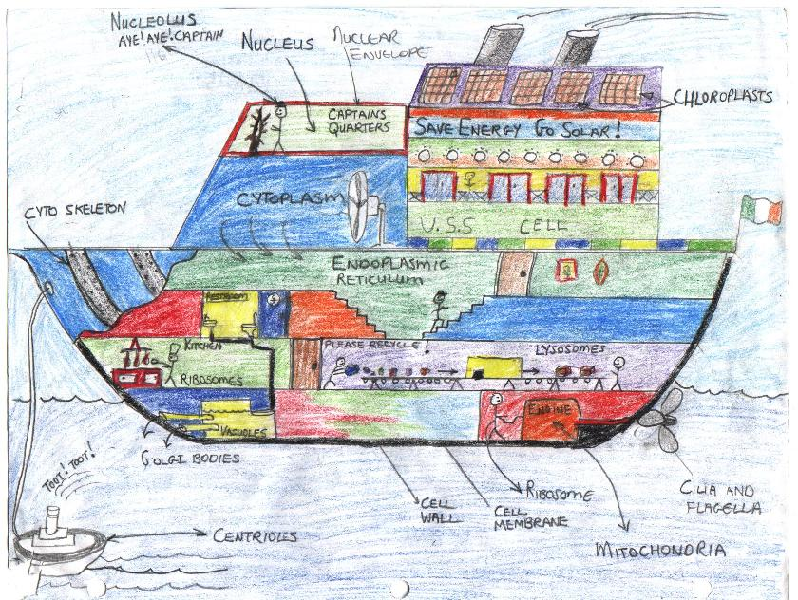

Slide 3
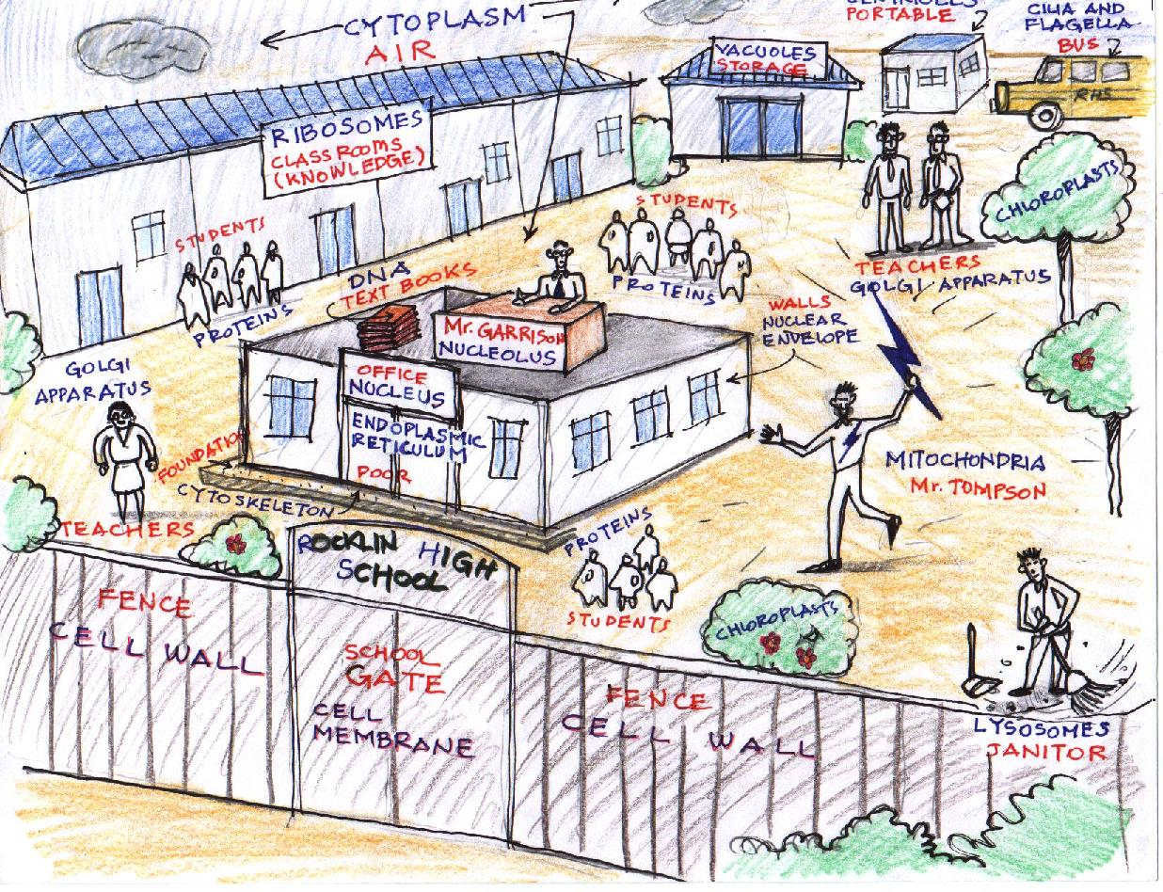

Slide 4
Topics to Choose From
Campsite
Theater
Grocery Store
City
Ship
School
Car
Computer
House
Prison

