Slide 1
Classification
Challenge
Do you know the mammals?

Slide 2
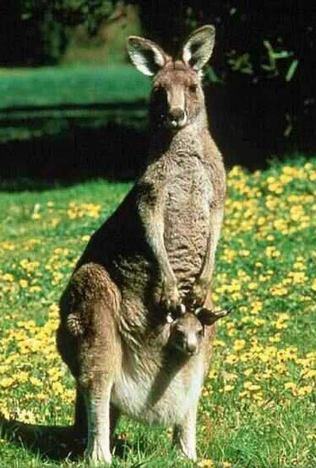
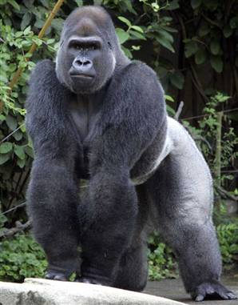
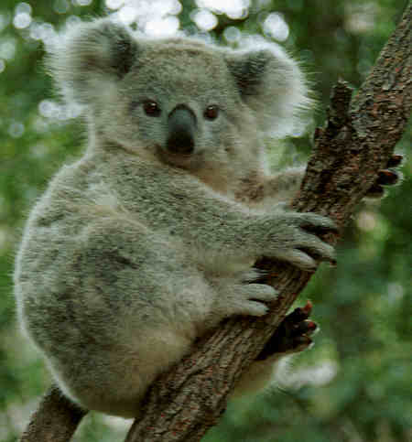
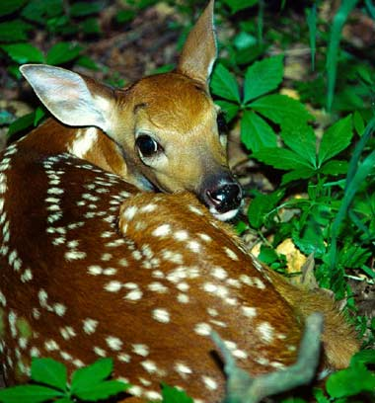
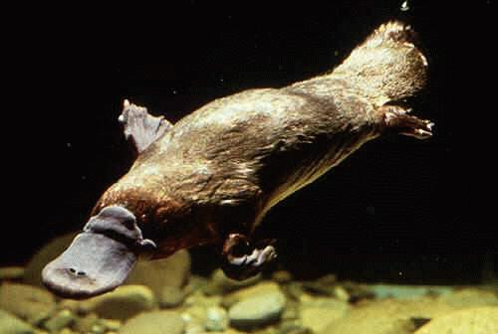
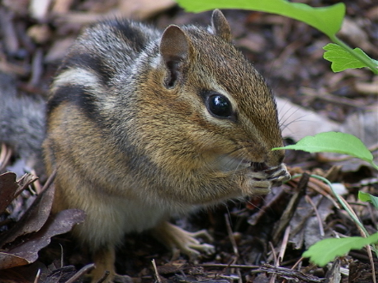
Classify each mammal into its correct group.
MP – Marsupial
MO – Monotremes
PL – Placental
1. Gorilla
4. Kangaroo
2. Koala
5. Deer
3. Platypus
6. Chipmunk

Slide 3
The answers are …
MP – Marsupial
MO – Monotremes
PL – Placental
PL
MP
1. Gorilla
4. Kangaroo
2. Koala
5. Deer
MP
PL
3. Platypus
6. Chipmunk
MO
PL

