Slide 1
Cladograms
Unit III: Biological Evolution

Slide 2
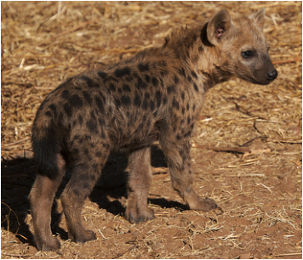
Evolutionary Classification
Phylogeny = the study of evolutionary relationships
Biologists now group organisms into categories that represent evolutionary descent (and not just physical similarities)
How would you classify a hyena? Would you group it with cats or dogs?
Photo credit flickr: ibeatty

Slide 3
Derived Characters
Characteristics that appear more recently in a group but are not seen in older organisms
Derived characters are used to construct a CLADOGRAM • a diagram that shows evolutionary relationships

Slide 4
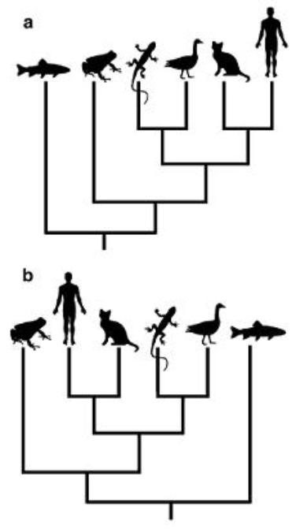
Cladograms
A diagram that shows evolutionary relationships

Slide 5
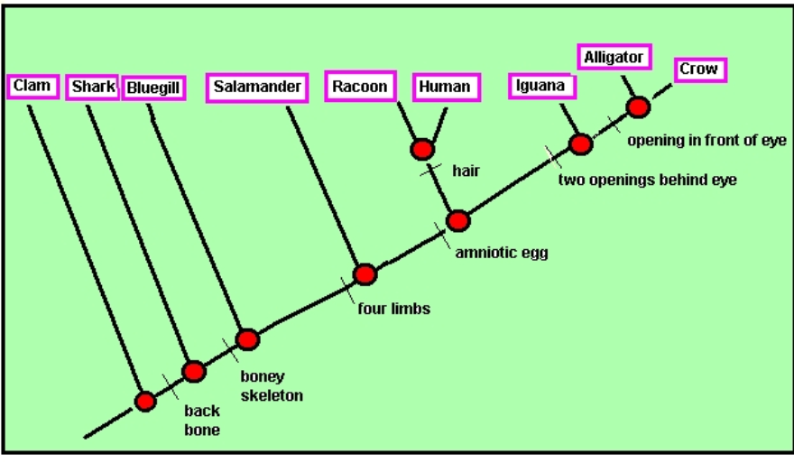

Slide 6
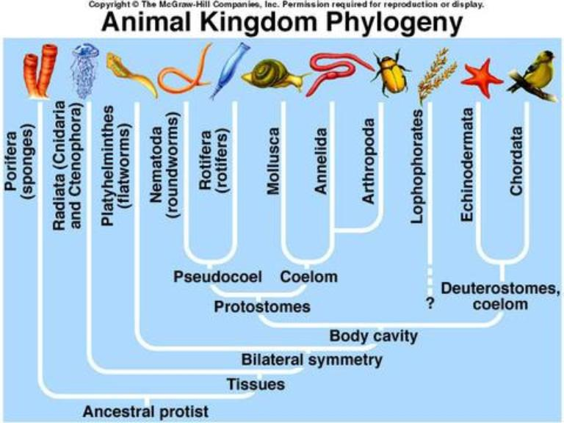

Slide 7
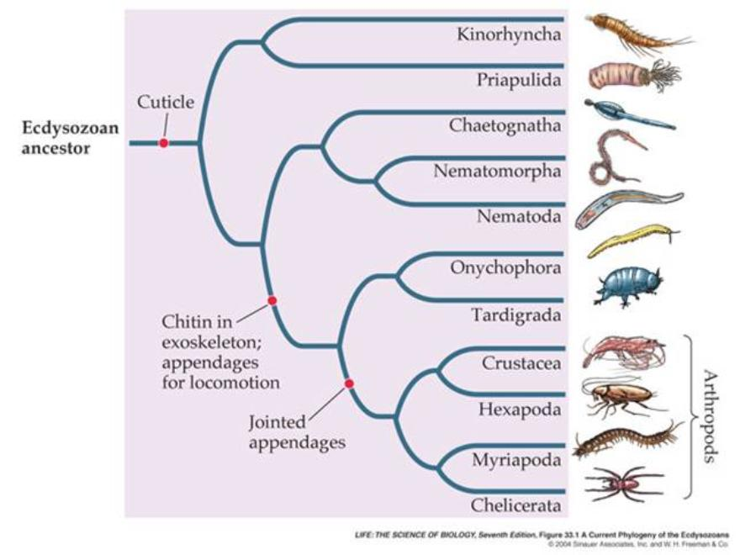

Slide 8
HOW TO BUILD A CLADOGRAM
Watch this animation on how to build a cladogram
http://ccl.northwestern.edu/simevolution/obonu/cladograms/Open-This-File.swf

Slide 9
Check for Understanding
A diagram that shows an evolutionary relationship is a ________________________
A characteristic that appears only in recent members is called a ________________ character
The study of evolutionary relationships is called __________________________

