Slide 1
Classification of Living Things

Slide 2
What is classification?
Classification is the grouping of living organisms according to similar structures and functions.

Slide 3
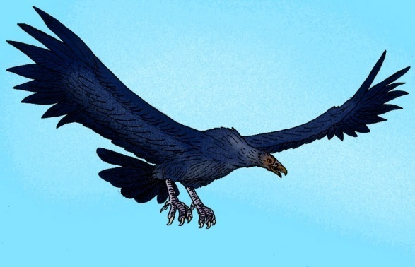
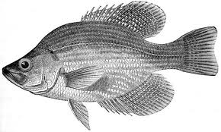
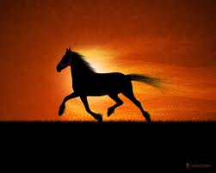
Early classification systems
Aristotle grouped animals according to the way they moved

Slide 4
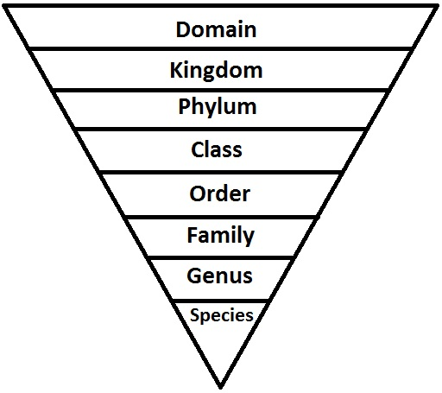
The modern classification system :
Developed by Carolus Linnaeus

Slide 5
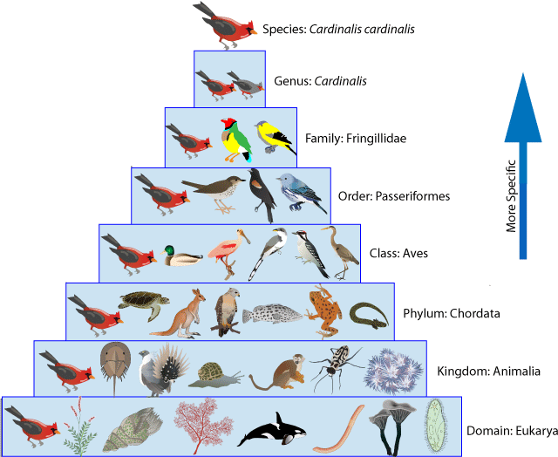

Slide 6
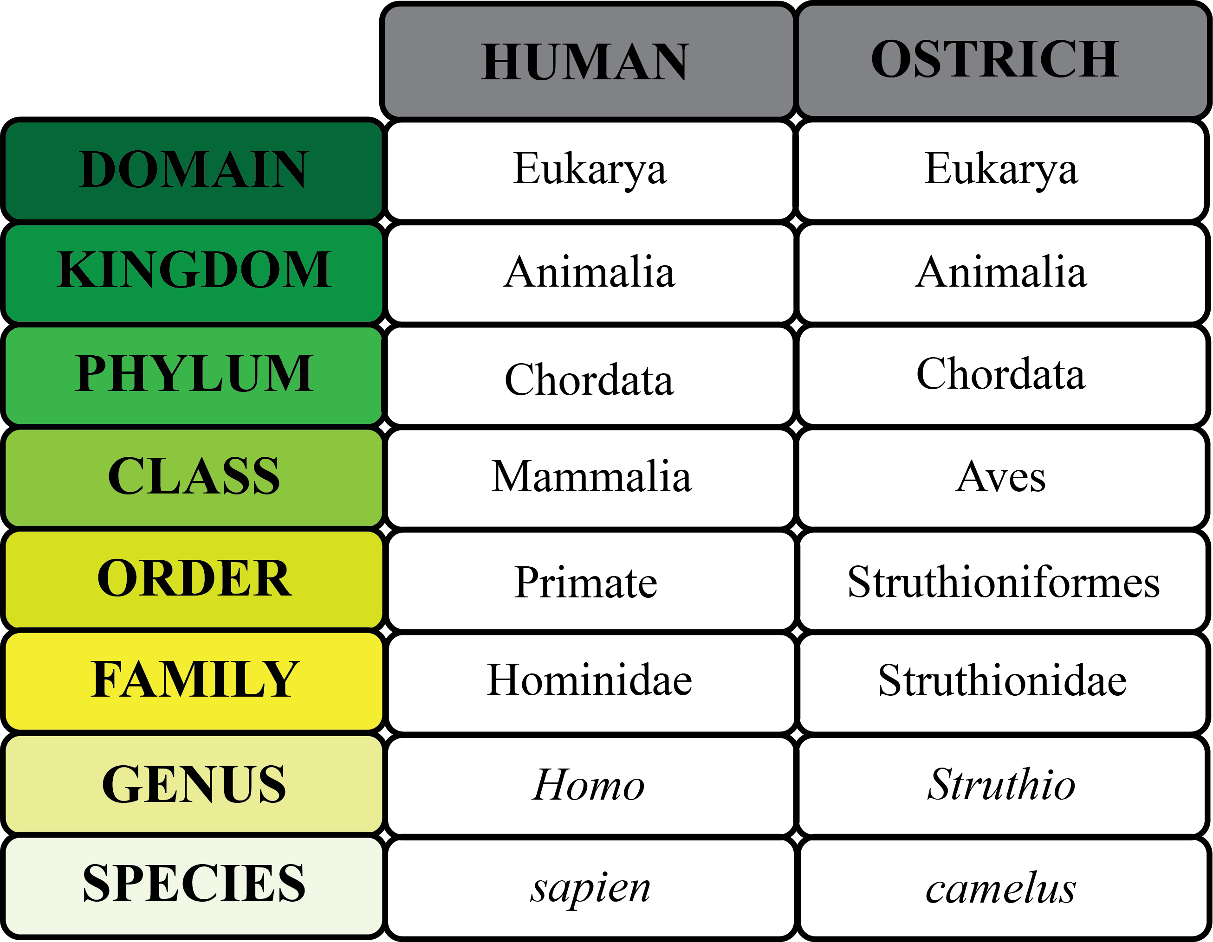

Slide 7
Helpful way to remember the 8 levels
Dr. King Philip Came Over For Grape Soda.
Dr. King Philip Came Over For Green Skittles.

Slide 8
Binomial Nomenclature
Developed by Carolus Linnaeus
Two-name system:
First name is the organism’s genus
Second name is the organism’s species

Slide 9
What rules are used to write scientific names?
The first letter of the GENUS is ALWAYS capitalized
The first letter of the SPECIES is NEVER capitalized
Scientific names of organisms are always italicized or underlined

Slide 10
Using the Classification System
Field guides help identify organisms.
-they highlight differences between similar organisms (like trees)
Taxonomic Key (Dichotomous Key)
-paired statements that describe the physical characteristics of different organisms

Slide 11
Taxonomic Key
1a Fruits occur singly ....................................................... Go to 3
1b Fruits occur in clusters of two or more ......................... Go to 2
2a Fruits are round ....................................................... Grapes
2b Fruits are elongate ................................................... Bananas
3a Thick skin that separates easily from flesh .............Oranges
3b Thin skin that adheres to flesh .............................. Go to 4
4a More than one seed per fruit ............................ Apples
4b One seed per fruit ............................................ Go to 5
5a Skin covered with velvety hairs .................... Peaches
5b Skin smooth, without hairs ........................... Plums
What steps would you use to identify a peach?

